Slide 1




FINAL PROJECT
Goup 9

Slide 2






TEAM MEMBERS
Group 9
Johnny Wang
Jessie Yang
Ariel Zhu
Shampire Wang
Personal Description
Personal Description
Personal Description
Personal Description

Slide 3


Table
of
Content
Topic Selected
Source of Data
Analysis Phases
Technologies, Languages, Tools & Algorithms
Results
Recommendations for Future Analysis
Difficulties Met

Slide 4

Part 1
TOPIC SELECTED
GTA Area housing/condo
price prediction
((maybe two similar cities comparison to predict potential crash of the price)
APIs to detect the volume flow in
Area Markdown
Type Markdown
Time Period
Toronto Downtown
Condo
From 2000 to 2021 - Monthly

Slide 5

Part 2
SOURCE OF DATA
Statistic Canada
World Bank
School Boards

Slide 6
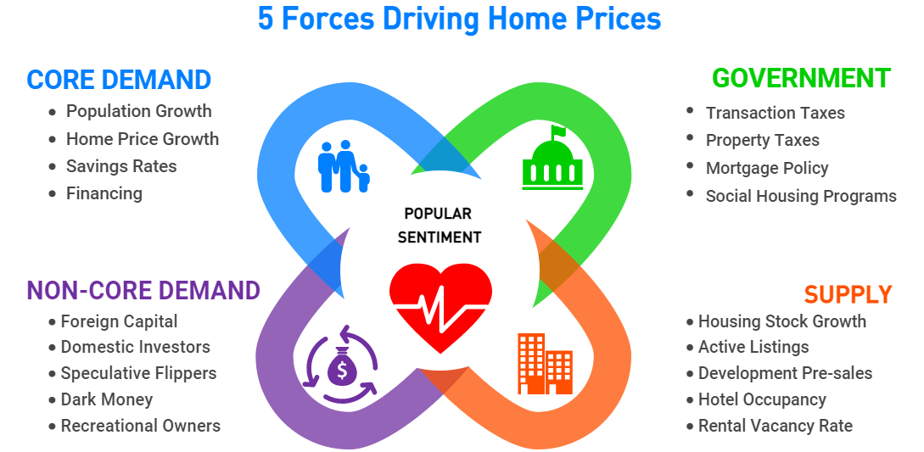
FACTORS THAT AFFECT REAL ESTATE PRICES

Slide 7
DATA PIPELINE
Data Sources
Data ETL
Storage
Analytics
Delivery
Feature Engineering
NGO
Government
Public database
Example:
Statistic Canada
World Bank
Data Cleaning
Data Integration
Server
Feature Extraction
Feature Selection
Feature Modification
Build models
Cross-Evaluation
Webpage
Interactivity
Visualization
Notes:
In order to predict the condo price, we used data analytics. We followed this data pipeline, where we started by finding data sources. Then, we cleaned and transformed the data and stored the data in a server. This is followed by feature engineering. Next, we built the model, evaluated the model, and generated the forecast, which was then delivered to the end user in an interactive webpage.

Slide 8
FACTORS THAT AFFECT
REAL ESTATE PRICES
Notes:
The first thing we did was doing research about what impact the real estate prices so that we know what data we should collect.

Slide 9
FACTORS THAT AFFECT REAL ESTATE PRICES
Indicators/factors:
Bank Prime Rate
Gold Price
NASDAQ Index
Toronto Population
Ontario Immigration
University of Toronto Total Enrolment
Unemployment Rate
New Condo planed for Construction
New Condo Completed
Total Sales
Target:
Average Price (Monthly)
Notes:
Here are some examples of the factors or indicators that we think are important to the forecast.

Slide 10

Building Models
A continuous number
Multivariate
Time Series
Small data size
Notes:
After cleaning and transforming the data, we want to build a model. Here is what the data looks like from 2001 to now. There are a few characteristics worth mentioning. First, price is a continuous number. Secondly, there are multiple variables that can affect the price and those variables are likely to have relationships among themselves. Thirdly, this is a time series. And finally, we have a small data size.

Slide 11
VECTOR AUTOREGRESSIVE (VAR) MODEL
Statistical Model:
Captures the relationship between multiple quantities as they change over time
Stochastic process model
Less demanding in information
Notes:
Based on these characteristics, we chose one called vector autoregressive model.
VAR is a time series statistical model that can capture the interrelationships and it is less demanding in information.

Slide 12
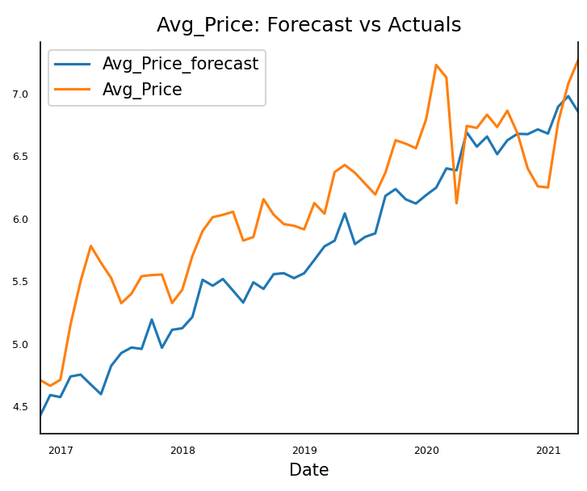
FORECAST VS. ACTUALS
Notes:
Here is a graph we generated when testing our model. The test data is from 2017 to 2021. As you can see, the forecast is very close to the actual prices. Most of the turning points are accurately predicted, but I guess the model didn’t see COVID coming.

Slide 13
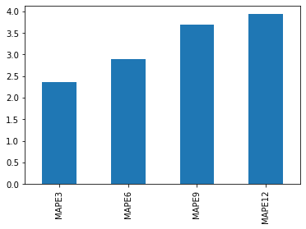
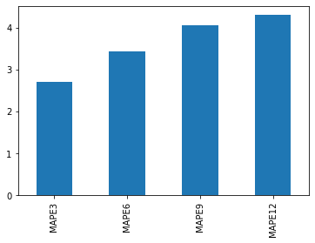
FORECAST VS. ACTUALS
Testing set: 2018-05-01 to 2019-04-01
Testing set: 2018-09-01 to 2019-08-01
Error %
Error %
Notes:
Using two sets of rolling window cross evaluation, we concluded that for a 3 month forecast, the average error of the forecast is around 2.5%. For a 12 month forecast, the error of is around 4%. The error will gradually become larger and larger as we forecast for longer terms. We think the result is reasonable, given the instability of the real estate market.

Slide 14
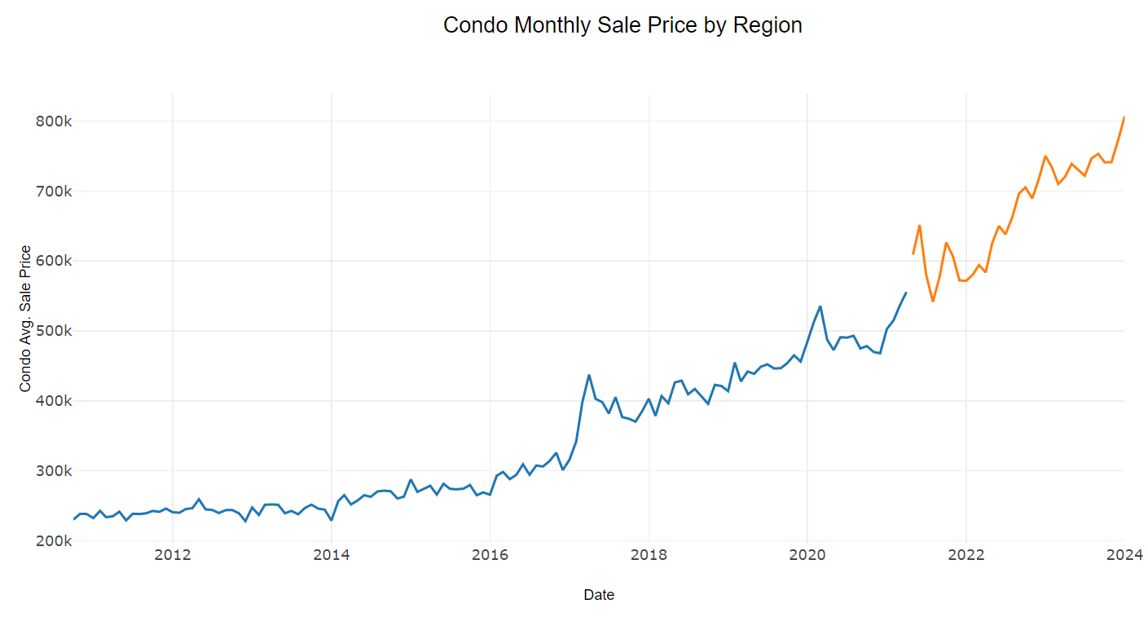
HISTORICAL + FORECAST
PREDICTION
HISTORICAL DATA
Notes:
This is the final forecast we produced from the model. We are confident that our model is accurate, at least for the first 12 months, but really how accurate it is, only time will tell. Now, let’s take a look at the webpage we built.
The blue curve is the historical data and the orange one is the prediction.

Slide 15
CROSS-EVALUATION
Training
Testing
2001-01-01
Total Dataset
2021-04-01

Slide 16
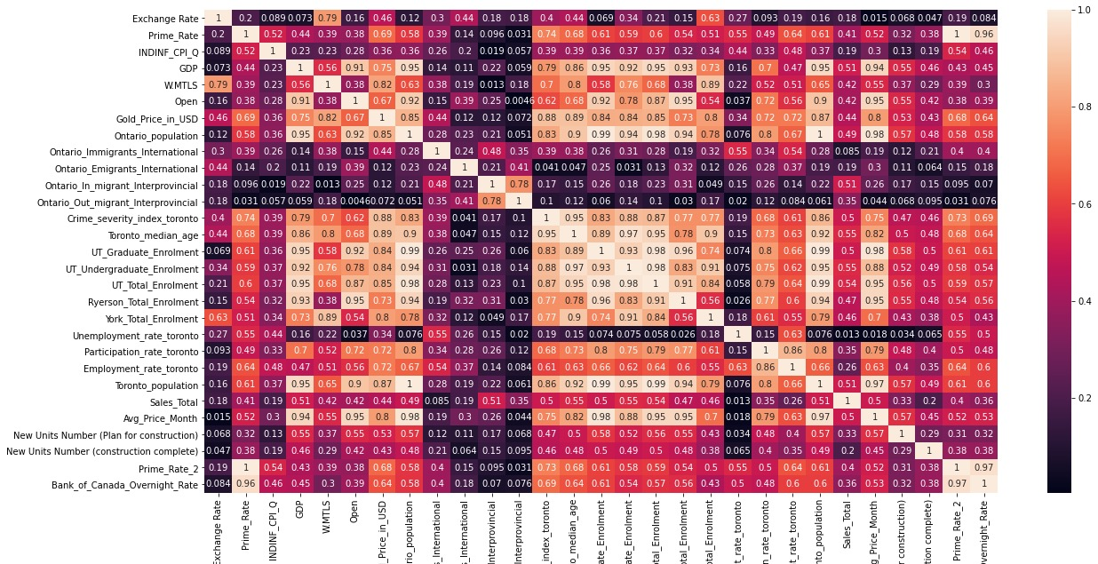
FEATURE CORRELATION HEATMAP
Notes:
We dropped some of the variables based on the correlation heatmap and our industry insights. For example, if two variables are highly correlated, one is dropped.

Slide 17

ANALYSIS PROCESS
Feature engineering
Construct VAR model
Fine tuning parameters
Rolling window cross-evaluation
Notes:
Next, we did feature engineering, and we constructed the model, spent a lot of time fine tuning the parameters, and then used rolling window cross-evaluation method to evaluated our model.

Slide 18

Part 3
Analysis Phases
Title
Phase 1 Phase 2 …

Slide 19
Period: 2000 - 2021
Rows = 255
Selected Features:

Slide 20


Part 4
Technologies, Languages, Tools & Algorithms
营销计划
顾客管理
外围宣传

Slide 21
Part 5
自我评价
演示文稿是一种交流工具，可以用作演示、报告等。演示文稿是一种交流工具，可以用作演示、讲座、演讲、报告等。
演示文稿是一种交流工具，可以用作演讲、报告等。演示文稿是一种交流工具，可以用作演示、讲座、演讲、报告等。

Slide 22




Part 6
履职能力
行业趋势判断
用户需求分析
资源整合能力

Slide 23
Thanks
FOR WATCHING

